Slide 1


Juego de Tiroteo
Guided by: Jalpesh Vasa
Prepared by: Priyal Ravat
ID: 16IT108

Slide 2

Agenda
Tiroteo
Screen Sort
1
2
3
4
5
Unreal Engine
Code
Resources

Slide 3
Unreal Enigne
May
1998
20 years ago
4.21
October 10
13 days ago
Epic Games
C++

Slide 4
What is Unreal Engine
Unreal Engine is first showcased in the 1998 first-person shooter game Unreal.
Although primarily developed for first-person shooters, it has been successfully used in a verity of other game.
With its code written in c++ the Unreal engine features a high degree of portability and is a tool used by many game developers today.
The current released is Unreal Engine 4, designed for Microsoft windows, macOS, Linux, IOS, Android, virtual reality, etc…..

Slide 5
Tiroteo
Juego de Tiroteo is a Spanish word it means that shootout game.
It is a first person shooting game, in it there is an character which moves forward, backward, right, left and jumps when we press the keys.
It also has main menu from where you can select to play, you can select to quit game and also change the resolution of the screen using main menu options tag.

Slide 6
Code
ProjectGameModeBase.h file:
// Fill out your copyright notice in the Description page of Project Settings.
#pragma once
//#include "CoreMinimal.h"
#include "GameFramework/GameModeBase.h"
#include "FPSProjectGameModeBase.generated.h"
/**
*
*/
UCLASS()
class FPSPROJECT_API AFPSProjectGameModeBase : public AGameModeBase
{
GENERATED_BODY()
virtual void StartPlay() override;
};

Slide 7
ProjectGameModeBase.cpp file:
// Fill out your copyright notice in the Description page of Project Settings.
#include "FPSProjectGameModeBase.h"
#include "FPSProject.h"
void AFPSProjectGameModeBase::StartPlay()
{
Super::StartPlay();
if (GEngine)
{
// Display a debug message for five seconds.
// The -1 "Key" value (first argument) indicates that we will never need to update or refresh this message.
GEngine->AddOnScreenDebugMessage(-1, 5.0f, FColor::Yellow, TEXT("Hello World, this is FPSGameMode!"));
}
}

Slide 8
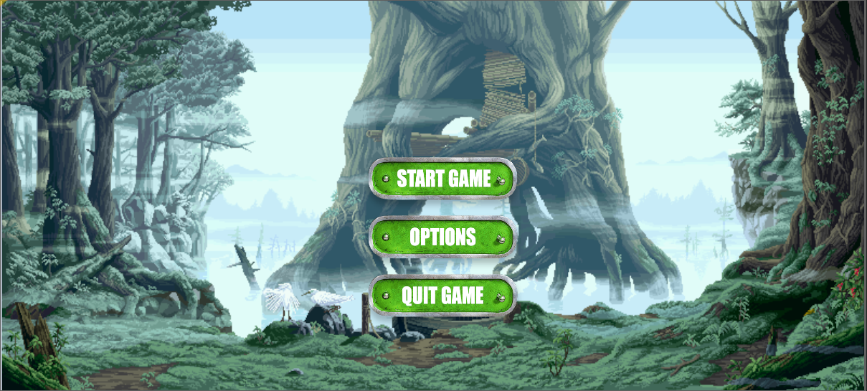
Screen sort

Slide 9
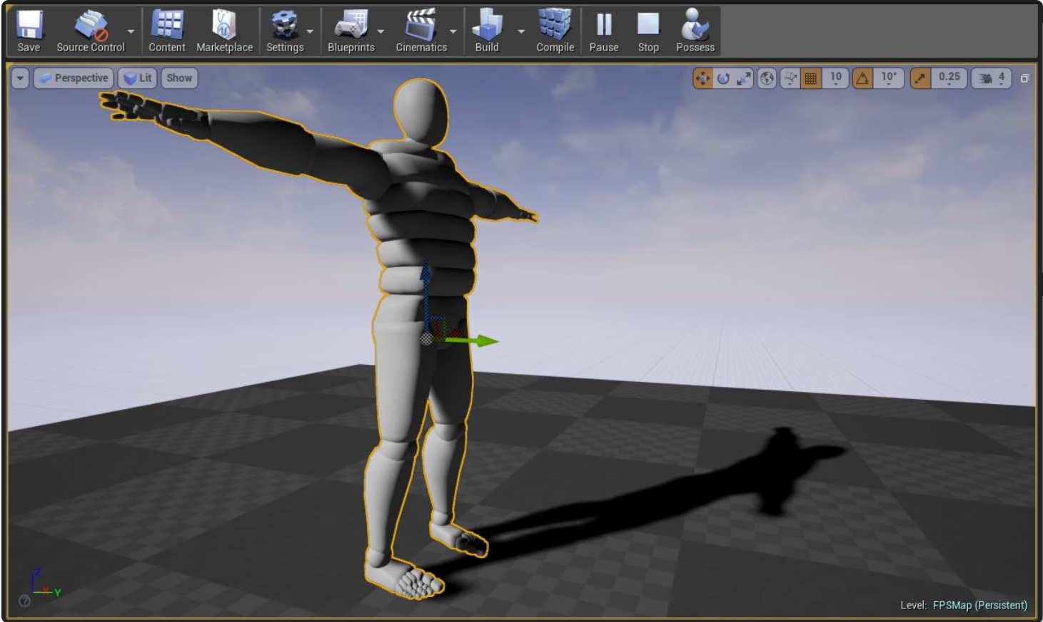
Screen short

Slide 10
Resources
www.wikipidia.com
www.unrealenigen.com

Slide 11

Questions

Slide 12
Thank you !!

